Slide 1
Community Connect
Requirements Analysis Document (RAD)
Group 3
18 AUGUST 2023

Slide 2
PRESENTATION OUTLINE
Introduction
Proposed System
System Models
Use Case Model
Analysis Object Model
Dynamic Model
User Interface

Slide 3
INTRODUCTION
Purpose of the System.
Community Connect is a dynamic digital platform designed to facilitate communication, interaction, and collaboration among diverse community members.
The system aims to bridge geographical gaps and create a sense of togetherness among community members.
It offers an innovative solution to overcome the limitations of traditional communication channels.
The platform empowers individuals to engage, share ideas, organize events, and respond swiftly to emergent needs.

Slide 4
Scope of the System
Event Management:
Creation, organization, and coordination of community events.
Users can create event listings and share event details.
Event organizers benefit from streamlined planning tools.
Emergency Alerts:
Robust Emergency Alert System for real-time critical information dissemination.
Enables prompt community response and coordination during emergencies.
User Profiles:
User profile functionality for personalized profiles.
Showcasing interests, affiliations, and contributions within the community.
Fosters a sense of identity and strengthens connections among members.
Donation Processing:
Facilitates secure and seamless donation processing.
Users can contribute funds to community initiatives through a trusted payment gateway.
Promotes philanthropy and supports various projects.

Slide 5
Objectives and Success Criteria of the Project
Improve Community Engagement:
Foster a vibrant and engaged community through a digital platform.
Facilitate meaningful connections and sharing of experiences.
Promote collaboration on community initiatives.
Streamline Event Organization:
Simplify organizing, promoting, and participating in community events.
Offer robust event management tools for greater efficiency and effectiveness.
Enable Efficient Emergency Alert Dissemination:
Establish a reliable Emergency Alert System.
Swift and accurate emergency information dissemination.
Empower community members to respond promptly and effectively to emergencies.
Event Participation:
Elevated rates of community event participation indicate success.
Well-attended events showcase effective event management and community involvement.

Slide 6
Proposed system
Functional requirements:
User Registration:
Platform provides user registration form with fields for username, email, and password.
Validates email format and ensures uniqueness.
User Authentication:
Offers login form with fields for username/email and password.
Email Verification:
Sends verification email upon successful registration.
Forgot Password Functionality:
Provides "Forgot Password" option on login page.
Event Creation:
Offers event creation form with fields for title, date, time, location, description, and category tags.

Slide 7
f) Event Categorization:
Categorizes events based on predefined or user-specified tags.
g) Event RSVP:
Users can RSVP for events or indicate interest.
Platform provides event reminders and notifications.
h) Emergency Alert Creation:
Provides authorized users with a dedicated form to create emergency alerts.
Donation Processing:
Provides secure payment gateway for user donations.
j) Campaign Creation:
Offers campaign creation form with fields for title, description, and optional media.
Users can add, edit, or delete campaigns they've created.

Slide 8
System models
User Scenario 1: Community Member
User: A resident who resides in the community.
Scenario:
The community member visits the Community Connect Platform.
The community member registers an account, and their verification is done by the chief or administrators.
After email verification, the community member signs in using their email credentials.
They complete their profile by adding interests and a profile picture.
They explore the Skill Sharing Hub, Community Announcements, and use the Emergency Alert System as needed.
The community member engages with the Secure Donation Platform, making donations, and participating in fundraising campaigns.
They also use the Volunteer Matchmaking, Community Forums, User Recognition and Rewards, and Privacy and Security features.

Slide 9
User Scenario 2: Community Organization
User: An enthusiastic community member who represents a community organization.
Scenario:
The user from a community organization logs in to the Community Connect Platform.
They post volunteer opportunities using the Volunteer Matchmaking feature.
They use the Community Announcements feature to post events and inform the community.
The user creates fundraising campaigns on the Secure Donation Platform, setting up campaign details.
They receive donations through the Secure Donation Platform and manage fundraising campaigns.
The user navigates to the event management section and uses the Create Fundraising Campaigns and Secure Payments features.
They keep track of attendees for events and use the platform to engage with the community.

Slide 10
User Scenario 3: Moderator
User: A community member responsible for moderating the platform.
Scenario:
The user with moderation responsibilities registers an account on the Community Connect Platform.
They assist in verifying user registrations for Community Members, Community Organizations, and other Moderators.
The user moderates’ content on the Community Forums feature, resolving conflicts and providing user support.
They also oversee fundraising campaigns on the Secure Donation Platform, ensuring proper functioning and resolving issues.
The user actively participates in resolving conflicts related to fundraising campaigns and user interactions.

Slide 11
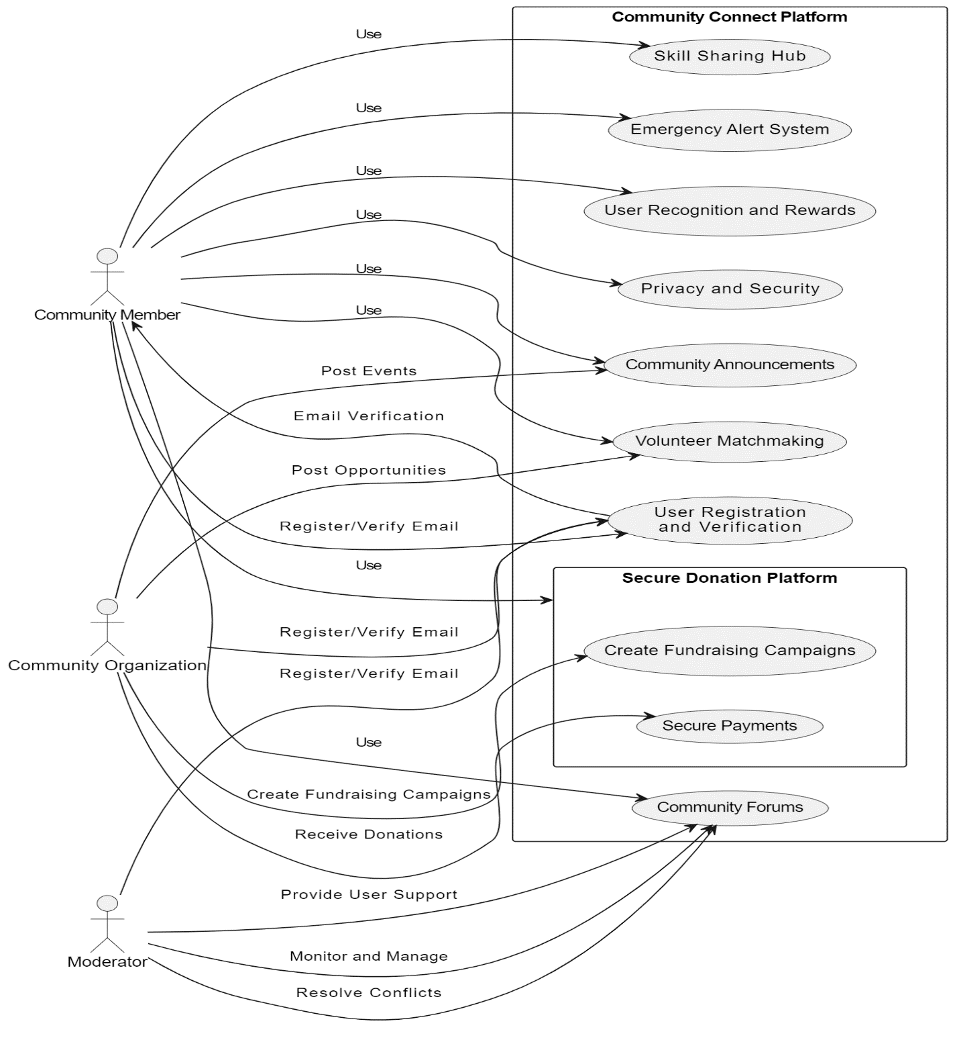
Use case model

Slide 12
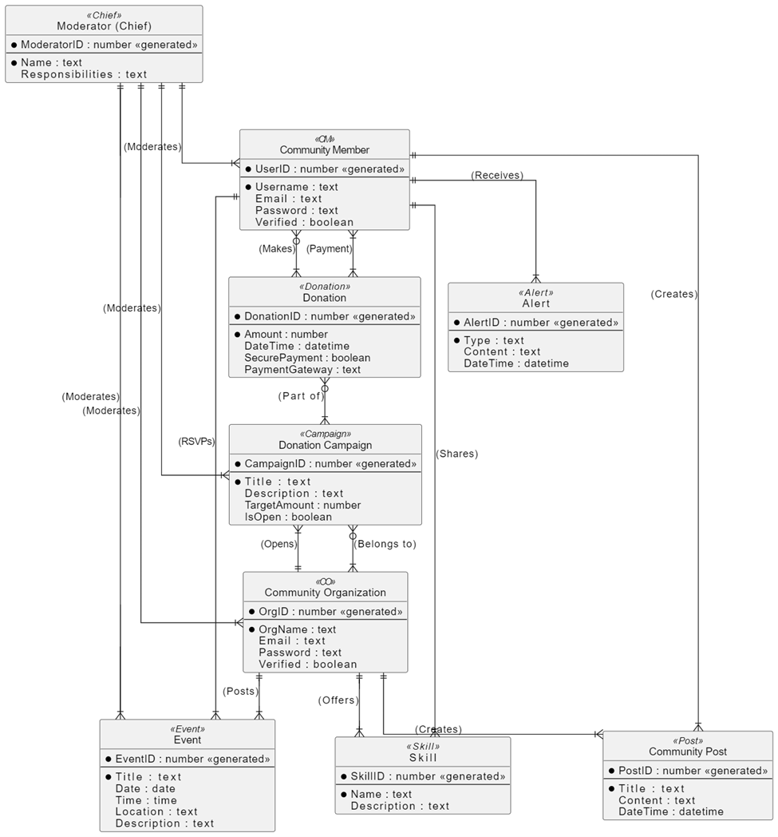
Analysis object model

Slide 13
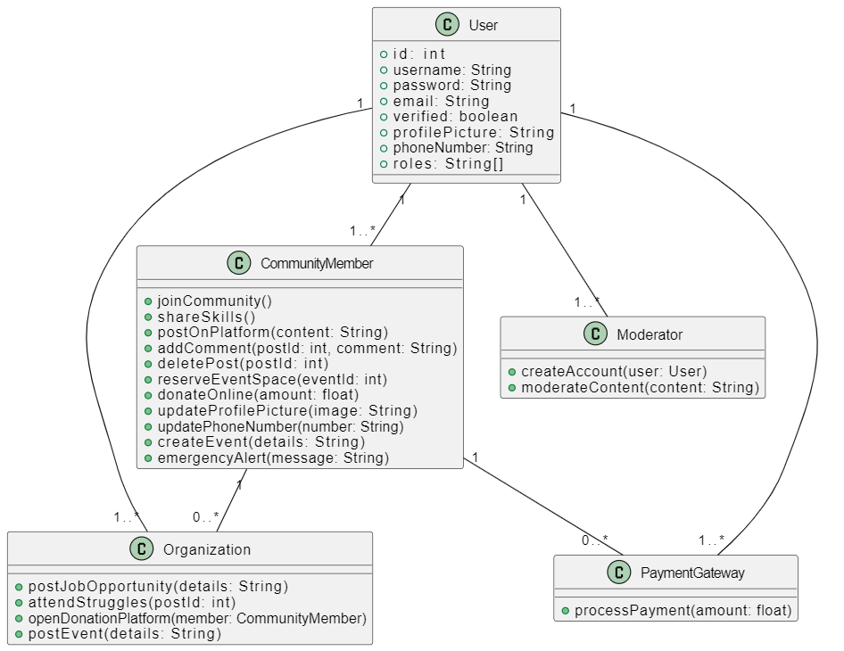
Dynamic model

Slide 14

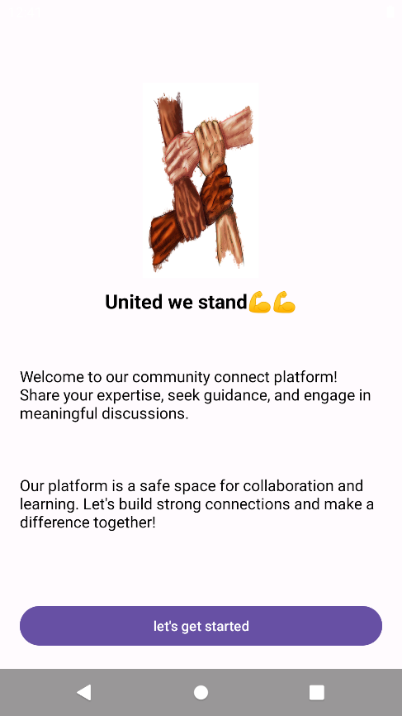
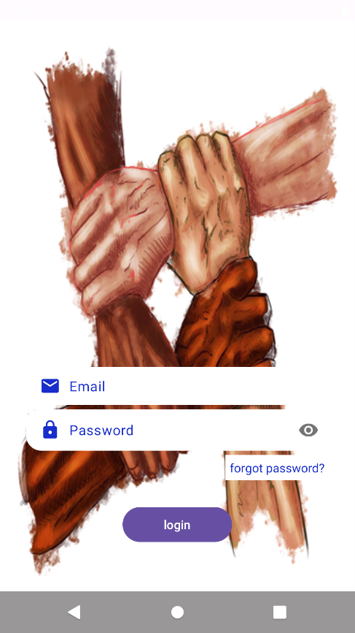
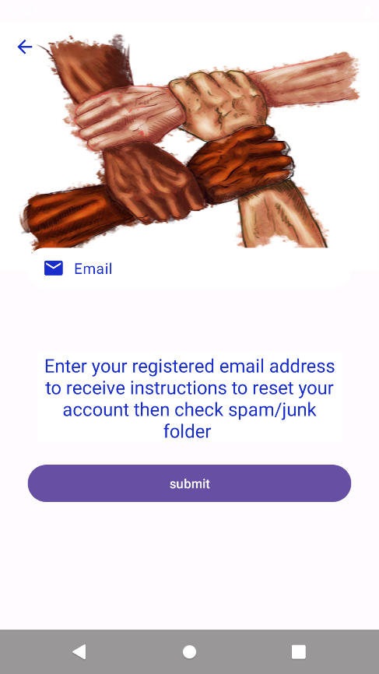
User interface

Slide 15
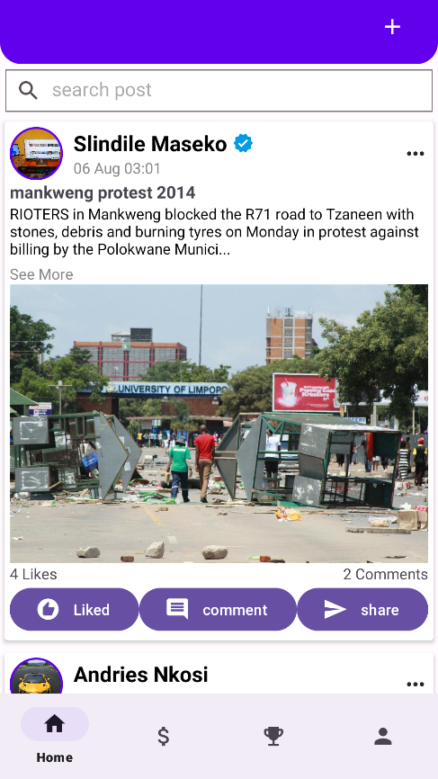
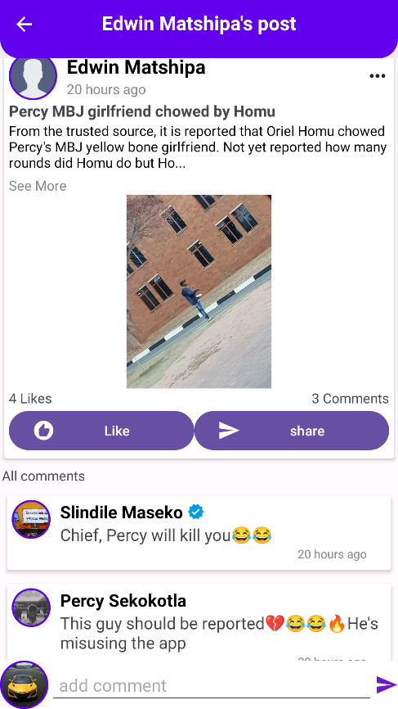
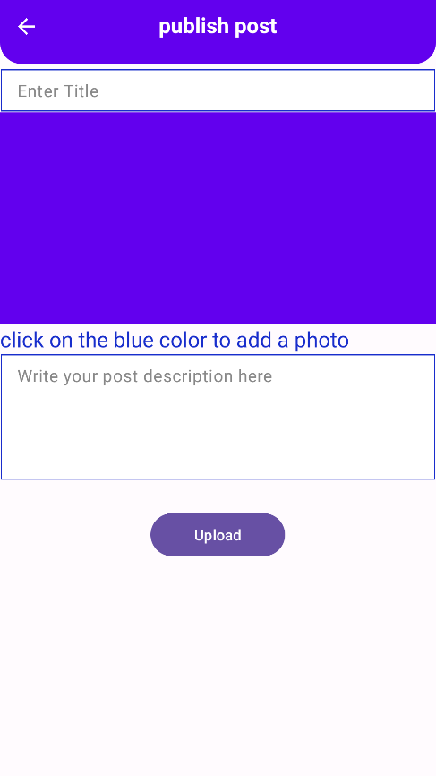
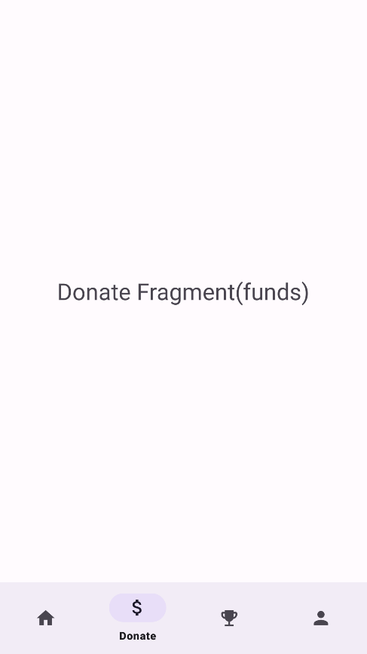

Slide 16
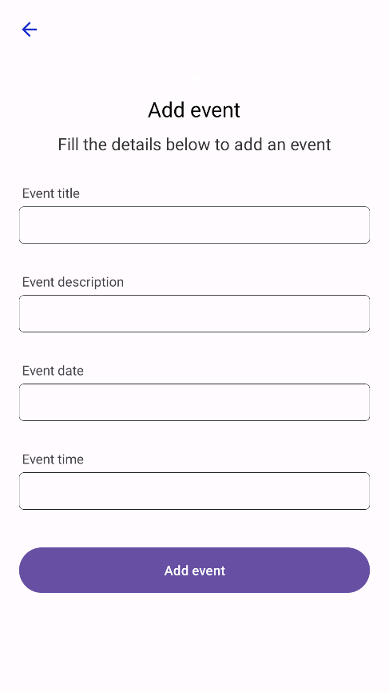
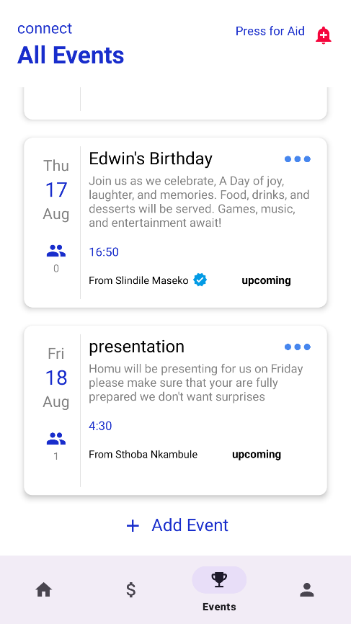
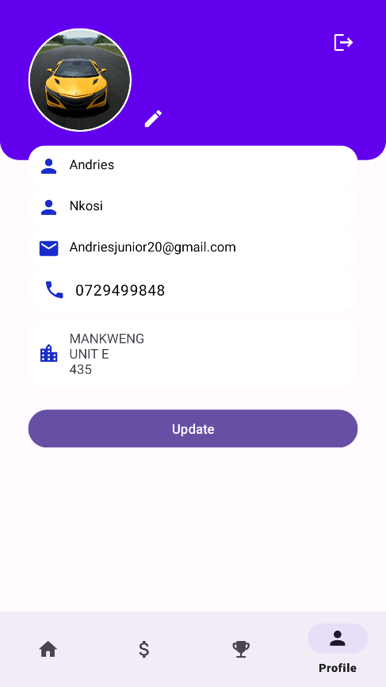

Slide 17



THANK YOU
GROUP 03
COMMUNITY CONNECT
RAD

